Slide 1
Poland
By Orla Devine

Slide 2
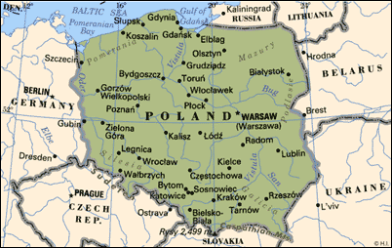
Poland’s POPULATION
Poland’s population is 37,739,785 that is a lot of people. Just imagine the population will be in years to come.

Slide 3
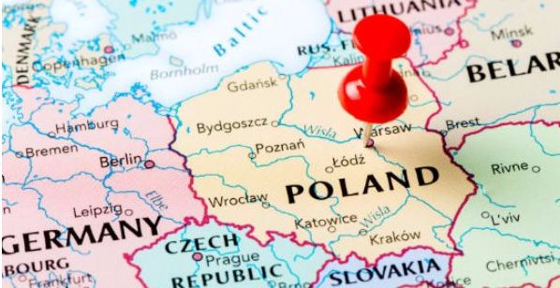
Where is Poland situated
Poland's extends from the Baltic Sea in the north to the Sudeten and Carpathian Mountains in the south.

Slide 4
Poland’s flag
The national flag of Poland consists of two horizontal stripes of equal width, the upper one white and the lower one red.

Slide 5
POLANDS MAIN RIVER
Poland’s main river is called the
Vistula River.

Slide 6
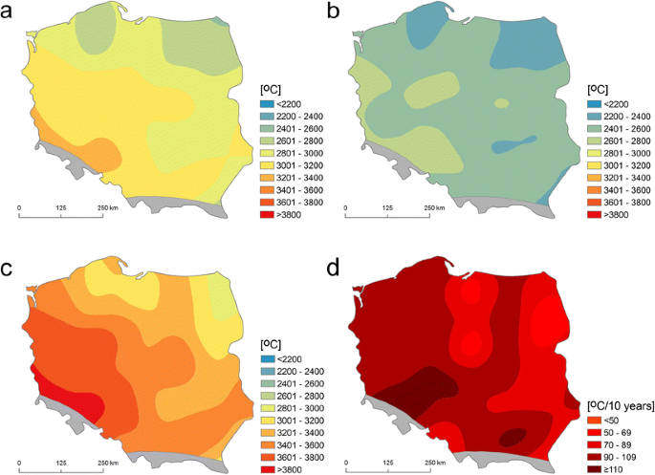
Poland’s weather
Coldest weather is -25 degrees to -35 degrees Celsius.
Hottest weather is 18 degrees.

Slide 7
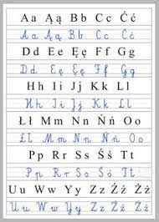
Language
This is how you say (hello in polish czesc)and this is how you say (goodbye in polish is do widzenia)

Slide 8
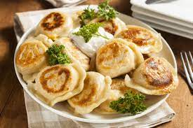
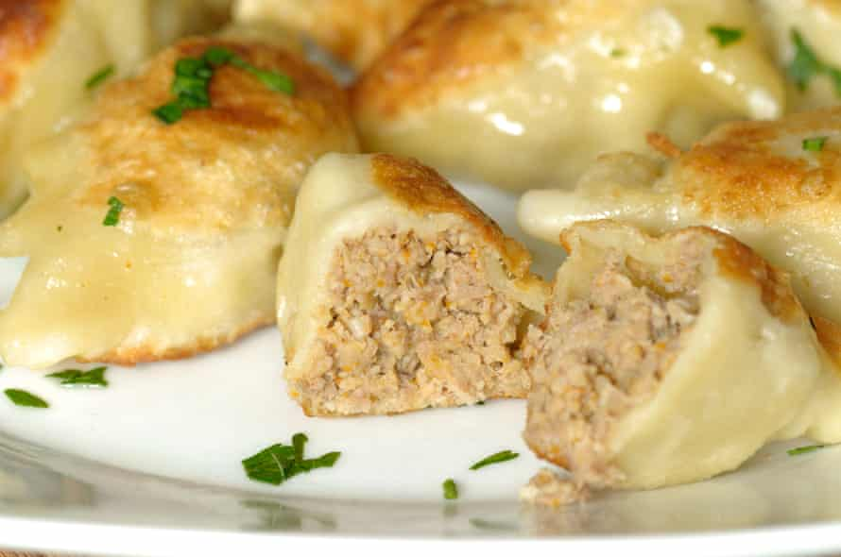
Main food
Poland’s main food is called Pierogi.
Pierogi is best know as dumplings.

Slide 9
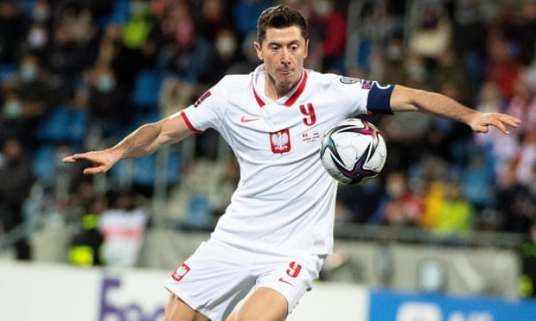
Poland’s main sport
Poland’s main sport is football. Most famous football player is Robert Lewandowski. Robert Lewandowski plays number 9 for Poland and is captain.

Slide 10
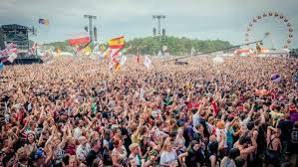
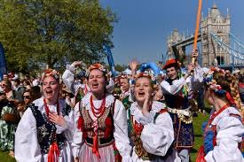
Best festivals in poland
The main festivals in Poland are New Year’s Eve, Easter celebrations and Saint Dominic’s fair.

Slide 11
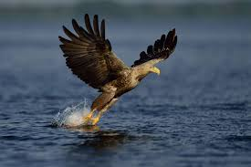
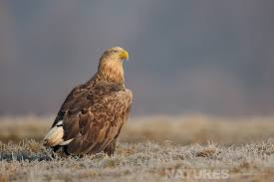
Animals
Poland’s most famous animal is a white tailed eagle.

Slide 12
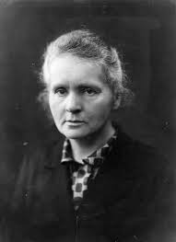
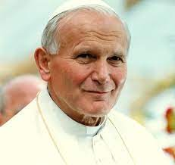
Famous people in poland
Pope John Paul 11
Marie curie
Frédéric Chopin
Nicolaus Copernicus
Peter Schmieichel
Joseph Conrad
Tommy Wiseay

Slide 13
industry
Poland’s industries are
agriculture,
manufacturing
and mining.

Slide 14
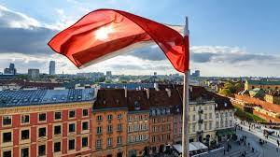
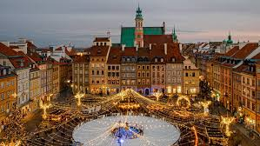
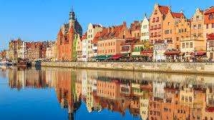
conclusion
Poland is a very large country. There are so many places to see and so many different types of clothing associated with its culture, that really stands out.
I would love to go some time and see all the cities.

Slide 15
Thank you for watching

