Slide 1
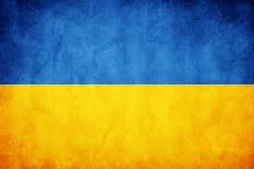
Ukraine
by Grace Quinn

Slide 2
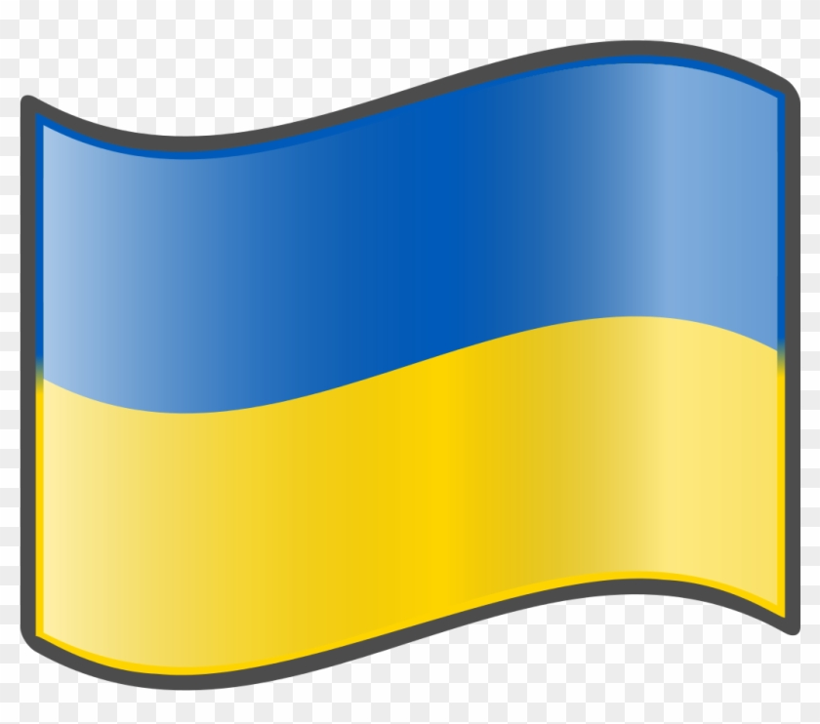
Ukraine
The capital of Ukraine is Kyiv (Kyiv is how we pronounce it) The flag looks like this →

Slide 3
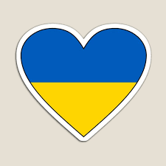
The population
The population in Ukraine is 44.13 million and is decreasing rapidly (2020)
Ukraine is situated in Eastern Europe

Slide 4
The main river of Ukraine
The main river in Ukraine is called Dnieper.
Its is 2,201 km long.

Slide 5
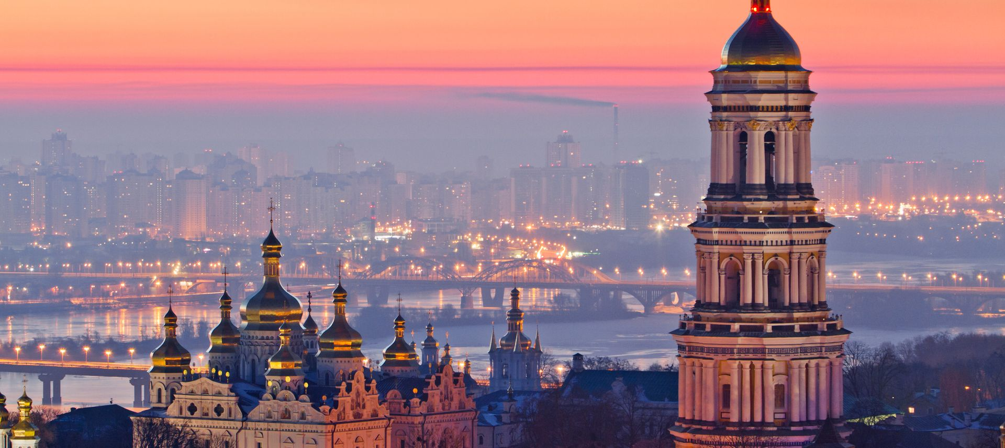
The Ukraine language
Hello in Ukrainian is=
Goodbye in Ukrainian=
Thank you=
How are you?=
The people of Ukraine speak Ukrainian or Russian.
Здравствуйте
до побачення
Дякую
як справи

Slide 6
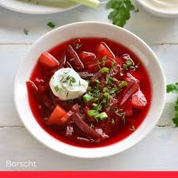
Food
Borsch is a soup made with beetroot, cabbage and other vegetables.
Borsht is know for its bright red colours and its amazing taste

Slide 7
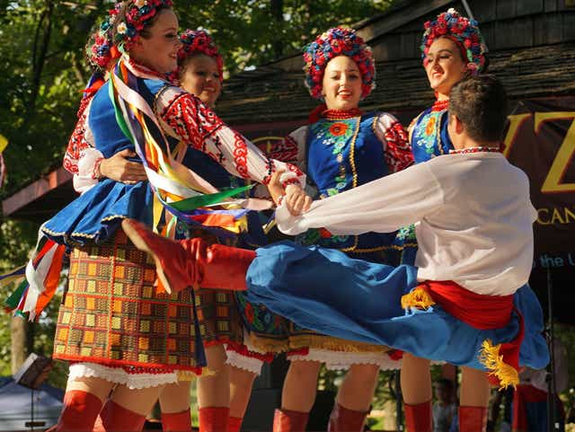
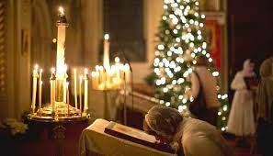
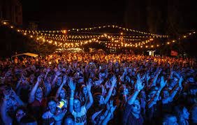
Famous festivals
The main festivals in Ukraine are orthodox Christmas and Kiev summer music festivals.

Slide 8
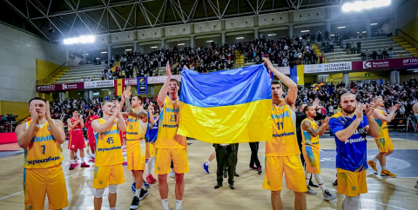
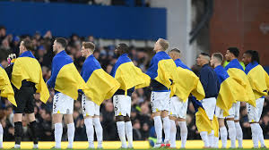
Sports
Ukraine's most popular sports are Football, Volleyball, Swimming, gymnastics and basketball.

Slide 9
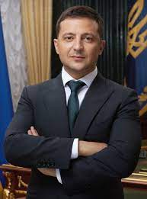
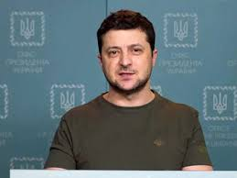
Famous Ukrainian
President Volodymur Zelenskyy is a famous Ukrainian. He got famous by being a stand up comedy actor and then he stopped stand up comedy to be just a normal actor, then he became president.

Slide 10
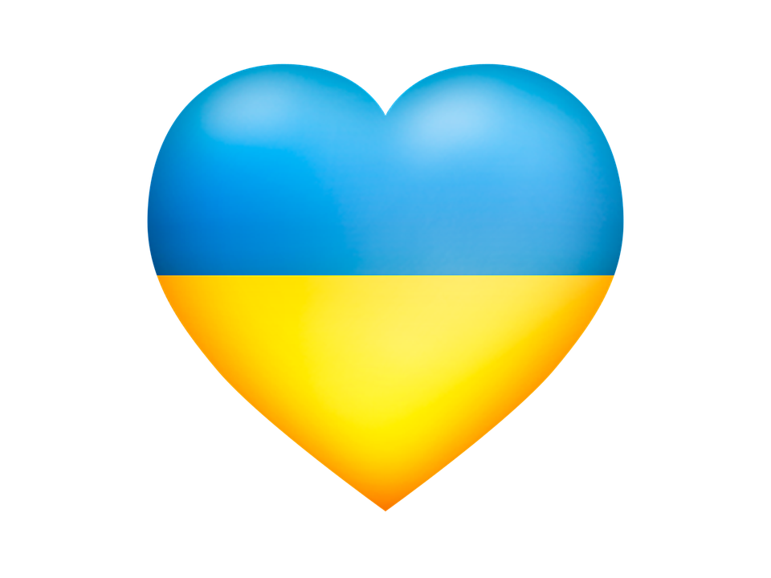
Conclusion
I think Ukraine is great and I would love to visit it in the future. I hope my Power point has been helpful!

Slide 11
Thank you!!
Thank you for reading/watching my PowerPoint!
By Grace Quinn

