Slide 1
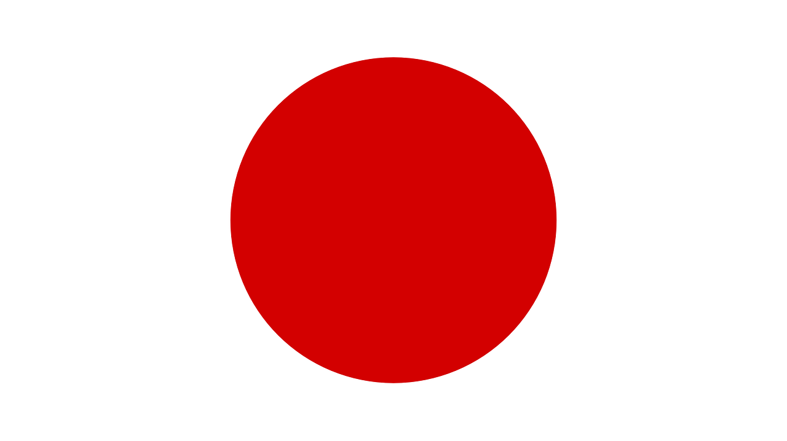
Japan by Alysha

Slide 2
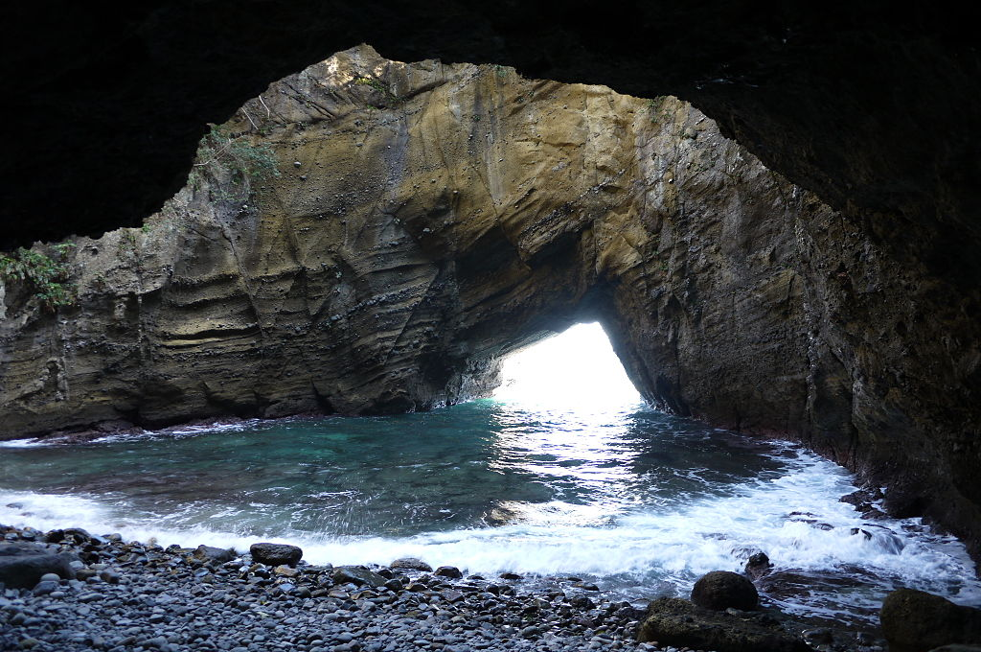
Rivers
The Shinano River is Japan's main river but there are also other rivers like Ryusendo river which has an underwater cave. Many people go scuba diving in it.

Slide 3
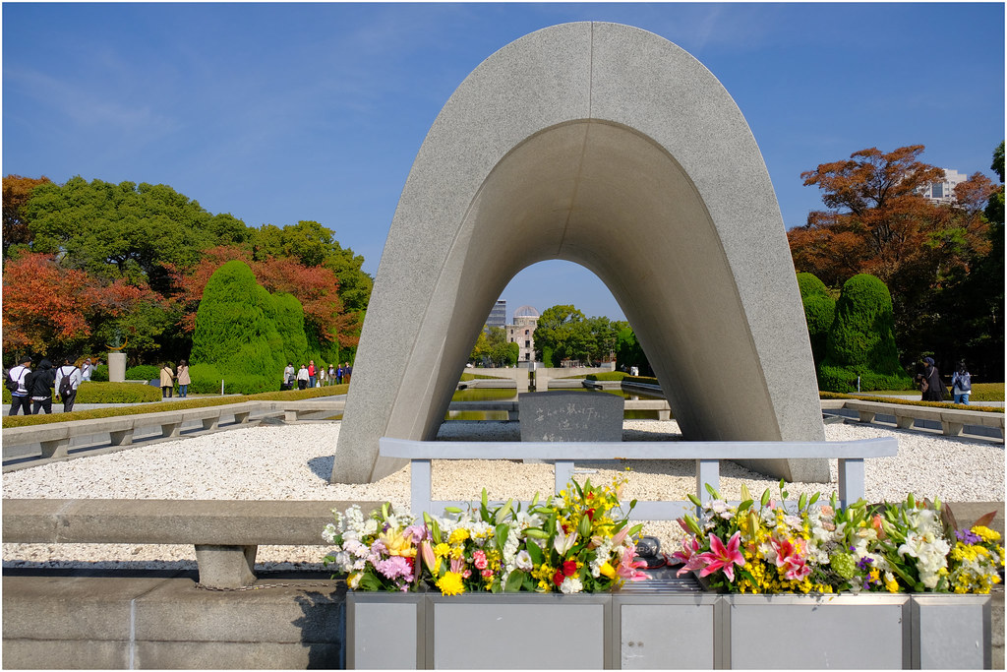
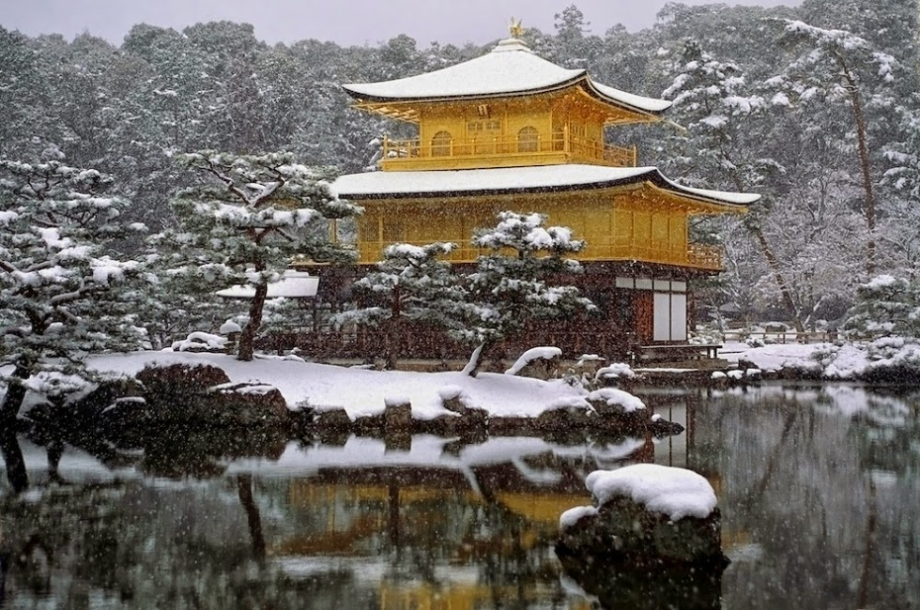
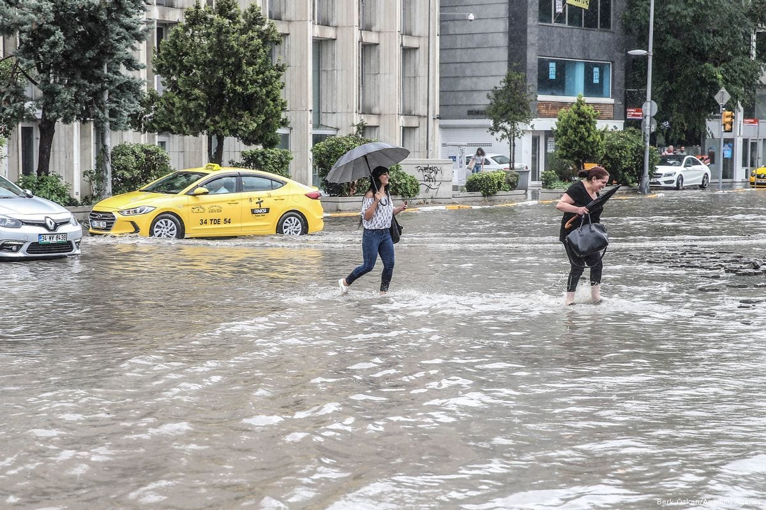
Tokyo
Weather
The warmest month is August and the coldest is January. The month with the most rainfall is October, and the least is December.

Slide 4
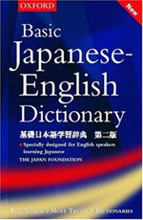
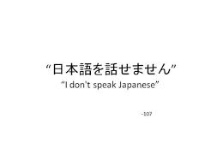
The Japanese language
How to say …...
Hello: kon'nichiwa
Bye: sayonara
No: ie
Yes: Hai
Thank you: arigato gozaimasu
No thank you: ie kekkodesu
You are welcome: doitashimashit

Slide 5
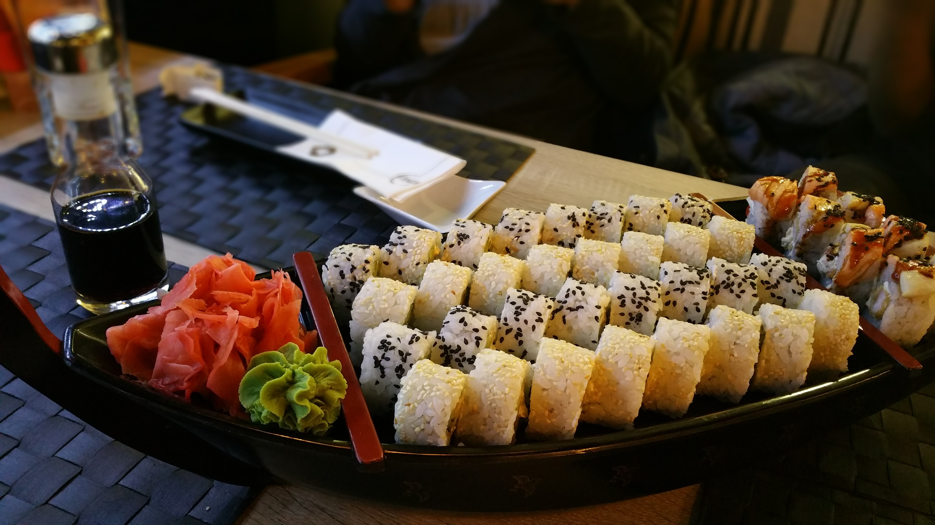
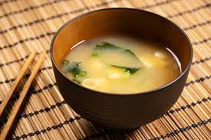
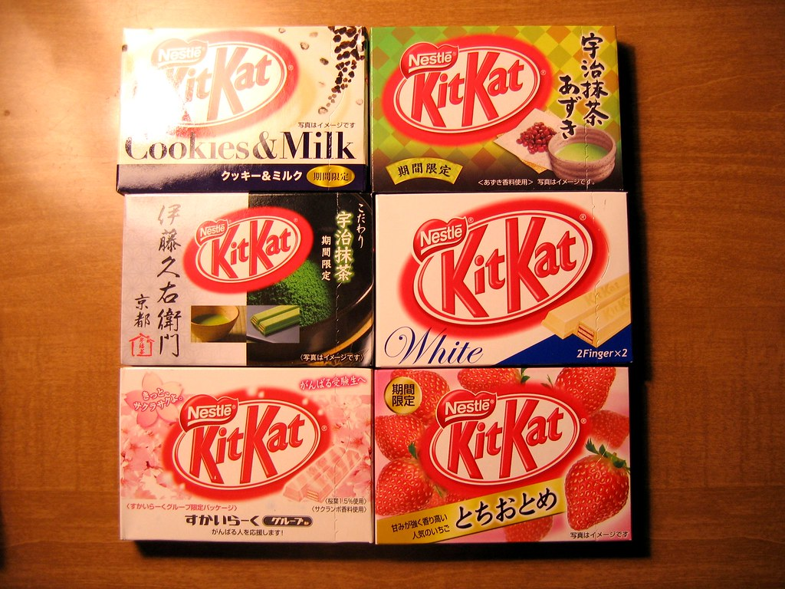
Foods
The Japanese are most known for rice with miso soup, but they also have a range of food that other countries don’t have like a range of KitKat and Doritos. Another one of their main dishes is sushi which is raw fish.
This Photo by Unknown author is licensed under CC BY-NC-ND.

Slide 6
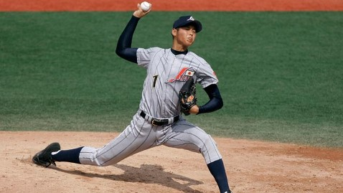
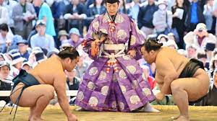
Sports
Japan's most known sports are sumo wrestling and baseball.
Tahio is Japan's most famous sumo wrestler. He weighed more than 300 pounds and died in Tokyo due to heart failure at the age of 72.
Ichiro Suzuki is there most famous baseball player. His batting hand is his left. He was born on October 22nd, 1973, and Is currently 48.

Slide 7
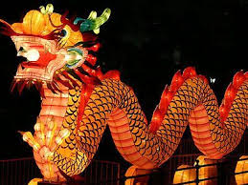
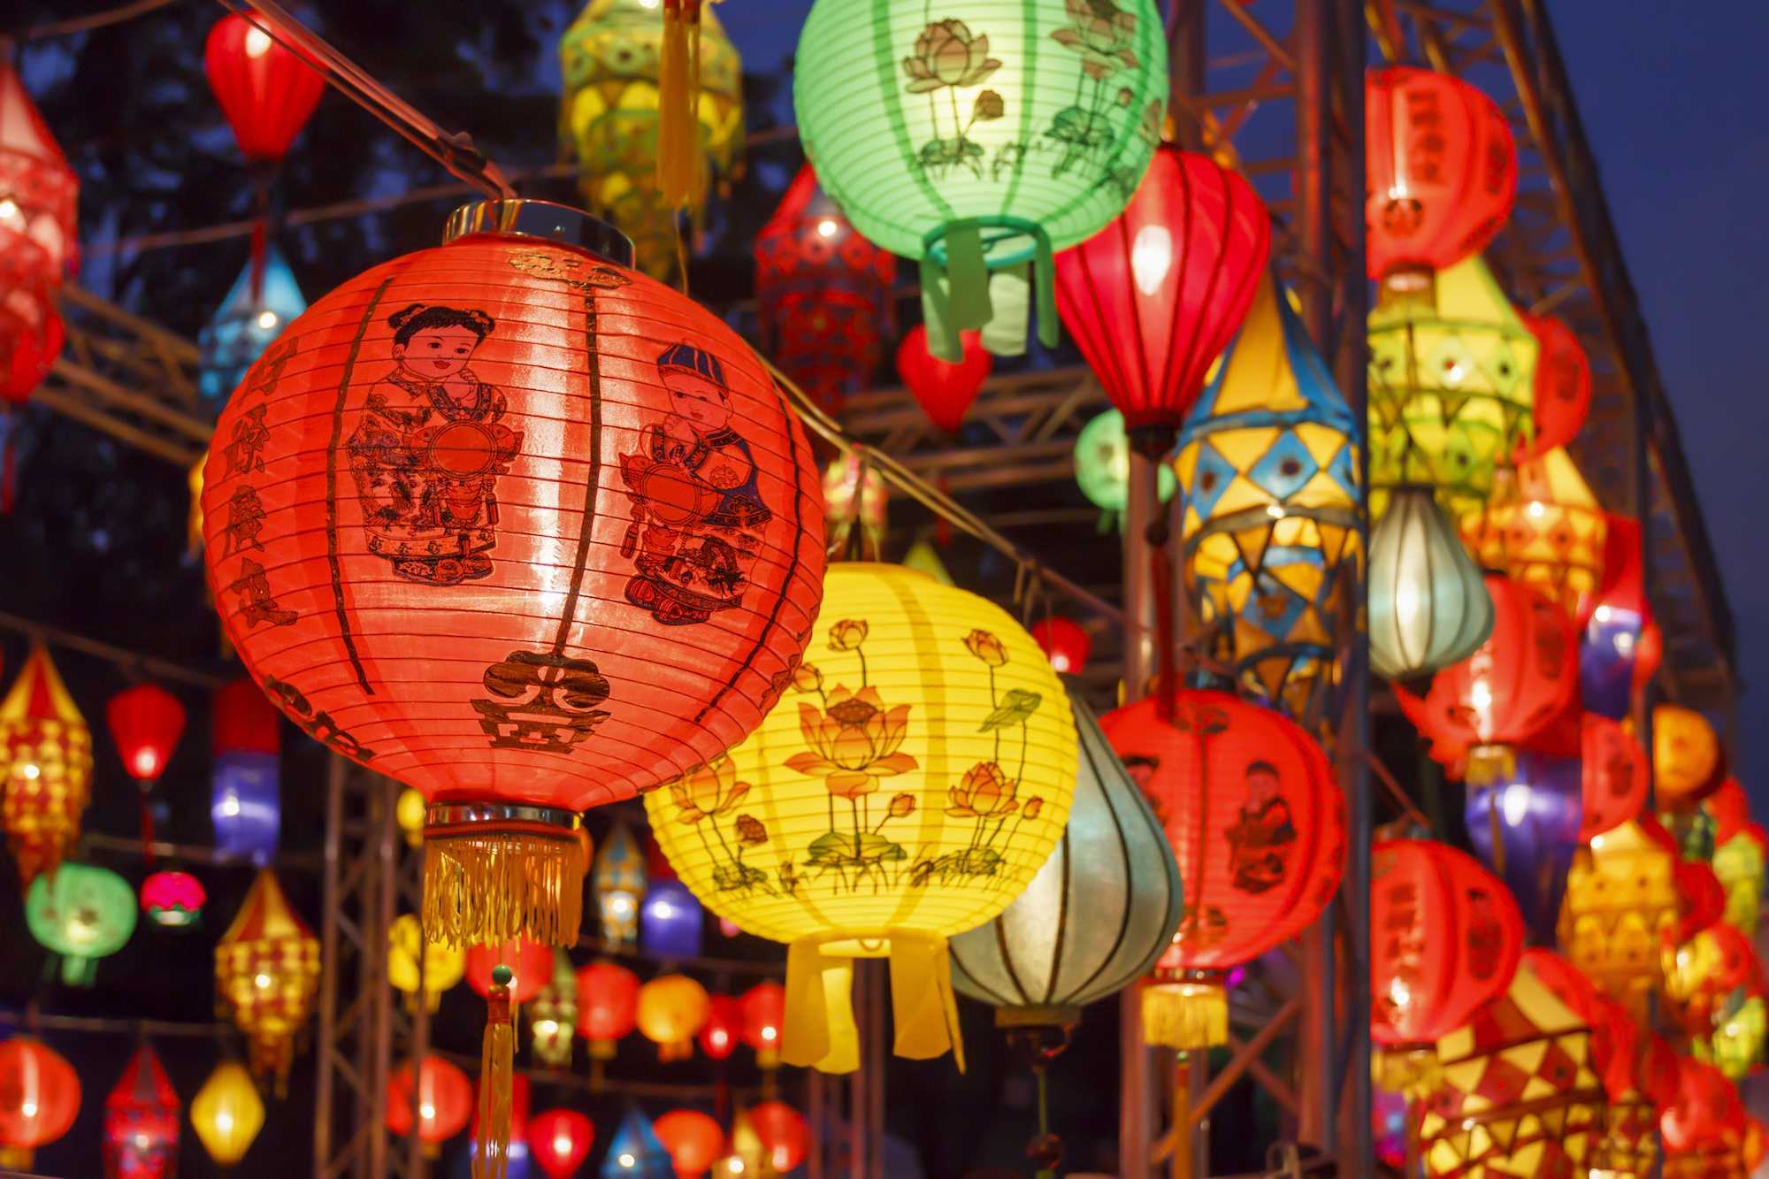
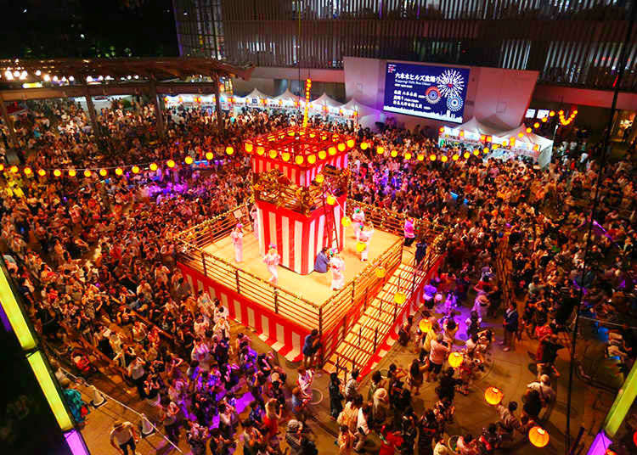
Holidays
In Japan they celebrate New Year's on January 1st .
Showa day is on the 29th April. This holiday celebrates the birthday of the Emperor Hirohito.
Constitution Day is another holiday in Japan that is held on the 3rd of May

Slide 8
Conclusion
Japan seems like an amazing country and after everything I've learnt about it I would love to go on a holiday there. I hope my PowerPoint has been helpful and thank you for watching

